Slide 1
Hyderabad Institute of Technology and Management
HUMAN MULTIPLE DISEASE PREDICTION USING
MACHINE LEARNING
BATCH NO : 04
STUDENT NAME ROLL NUMBER
P. RAVITEJA 19E51A0577
R. VIKAS 19E51A0589
V. SAI KRISHNA 19E51A05B6
P. AKASH 19E51A0579
Under the guidance of : DR. PADMAJA PULICHERLA
PROFESSOR
Project Stage -2(2022-2023)

Slide 2
List of Contents
ABSTRACT
PROBLEM STATEMENTS
INTRODUCTION
EXISTING SYSTEM
PROPOSED SYSTEM
DESIGN
IMPLEMENTATION
LITERATURE SURVEY
CONCLUSION

Slide 3
Abstract
Many of the existing machine learning models for health care analysis are concentrating on one disease per analysis. Like one analysis for diabetes analysis, one for Heart analysis, one for lung diseases, one for kidney analysis like that. There is no common system where one analysis can perform more than one disease prediction. In this proposing system which is used to predict multiple diseases by using Flask. In this system used to analyze Diabetes, Cancer, Heart, Kidney, Liver, Malaria, Stroke, Pneumonia, the accuracy of medical disease prediction has been continuously improved, and the performance in all aspects has also been significantly improved. It aims to clarify the effectiveness of machine learning in disease prediction and demonstrates the high correlation between machine learning and the medical field in future development. The performance of the proposed system is evaluated on the scales of accuracy. The results reveal the effectiveness of our proposed methodology in predicting multiple diseases in comparison to other benchmark methods. The disease prediction is accomplished based on the features extracted from the raw dataset. ​​

Slide 4
Abstract
To implement multiple disease analysis used machine learning algorithms and Flask Python pickling is used to save the model behavior. The importance of this analysis is to analyze the maximum diseases, so that to monitor the patient's condition and warns the patients in advance to decrease mortality ratio. Our research proposed to study machine learning algorithms like, Decision Tree (DT), Support Vector Machine (SVM), KNN, Random Forest (RF), Naive Bayes, logistic regression.
Keywords: Machine learning, Flask, Decision Tree, Support Vector Machine (SVM), Random Forest, LR, KNN.​​

Slide 5
PROBLEM STATEMENT:
Many of the existing machine learning models for health care analysis are concentrating on one disease per analysis. For example first is for liver analysis, one for cancer analysis, one for lung diseases like that. If a user wants to predict more than one disease, he/she has to go through different sites. There is no common system where one analysis can perform more than one disease prediction. Some of the models have lower accuracy which can seriously affect patients’ health. When an organization wants to analyse their patient’s health reports, they have to deploy many models which in turn increases the cost as well as time Some of the existing systems consider very few parameters which can yield false results

Slide 6
INTRODUCTION
In this digital world, data is an asset, and enormous data was generated in all the fields. Data in the healthcare industry consists of all the information related to patients. Here a general architecture has been proposed for predicting the disease in the healthcare industry. Many of the existing models are concentrating on one disease per analysis. In this system, we are going to analyze Diabetes, Heart, kidney and lung disease analysis. Later many more diseases can be included. To implement multiple disease prediction systems we are going to use machine learning algorithms, and flask. The importance of this system analysis is that while analyzing the diseases all the parameters which cause the disease is included so it is possible to detect the disease efficiently and more accurately.

Slide 7
EXISTING SYSTEM
Many of the existing machine learning models for health care analysis are concentrating on one disease per analysis. For example one for heart analysis, one for kidney analysis, one for lung diseases, Diabetes analysis like that. If a user wants to predict more than one disease, he/she has to go through different sites. There is no common system where one analysis can perform more than one disease prediction. Some of the models have lower accuracy which can seriously affect patients health. When an organization wants to analyze their patient’s health reports, they have to deploy many models which in turn increases the cost as well as time Some of the existing systems consider very few parameters which can yield false results.

Slide 8
Proposed System
In multiple disease prediction, it is possible to predict more than one disease at a time. So the user doesn’t need to traverse different sites in order to predict the diseases. We are taking three diseases that are lung, Diabetes, kidney and Heart. As all the three diseases are correlated to each other. To implement multiple disease analyses we are going to use machine learning algorithms and Flask. When the user is accessing this API, the user has to send the parameters of the disease along with the disease name. Flask will invoke the corresponding model and returns the status of the patient.

Slide 9
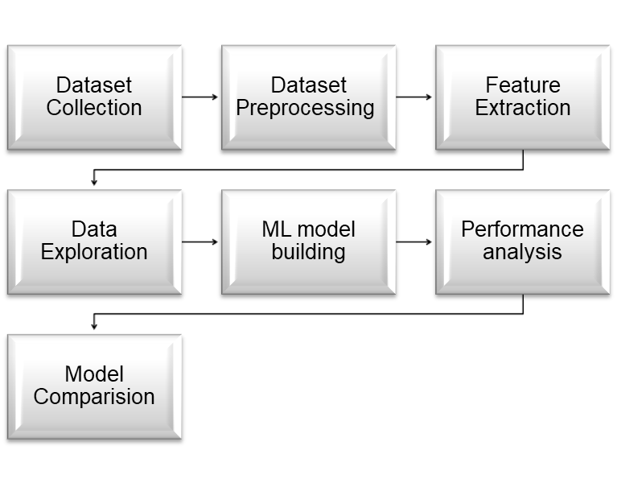
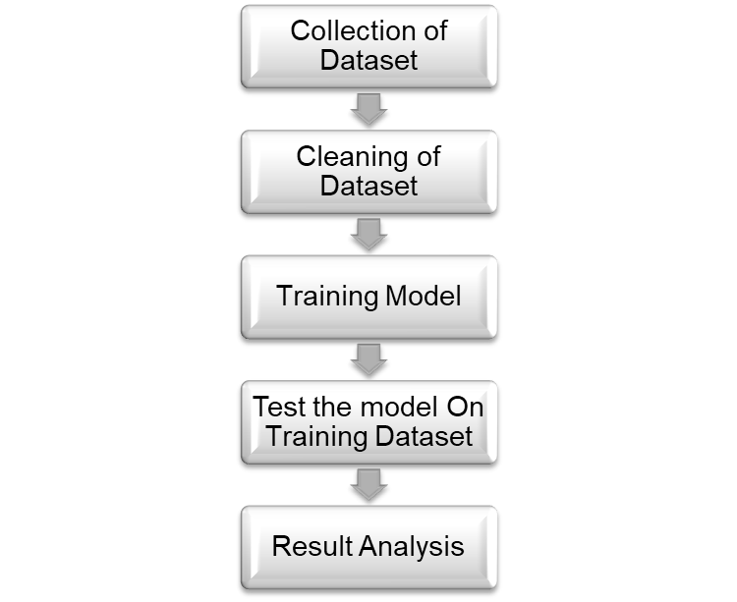
DESIGN
2.Model preview
1. Architecture of ML Model

Slide 10
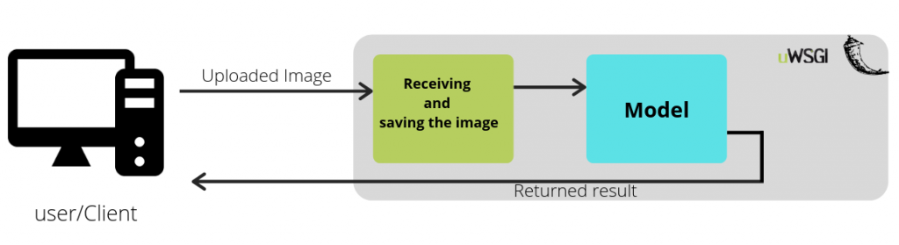
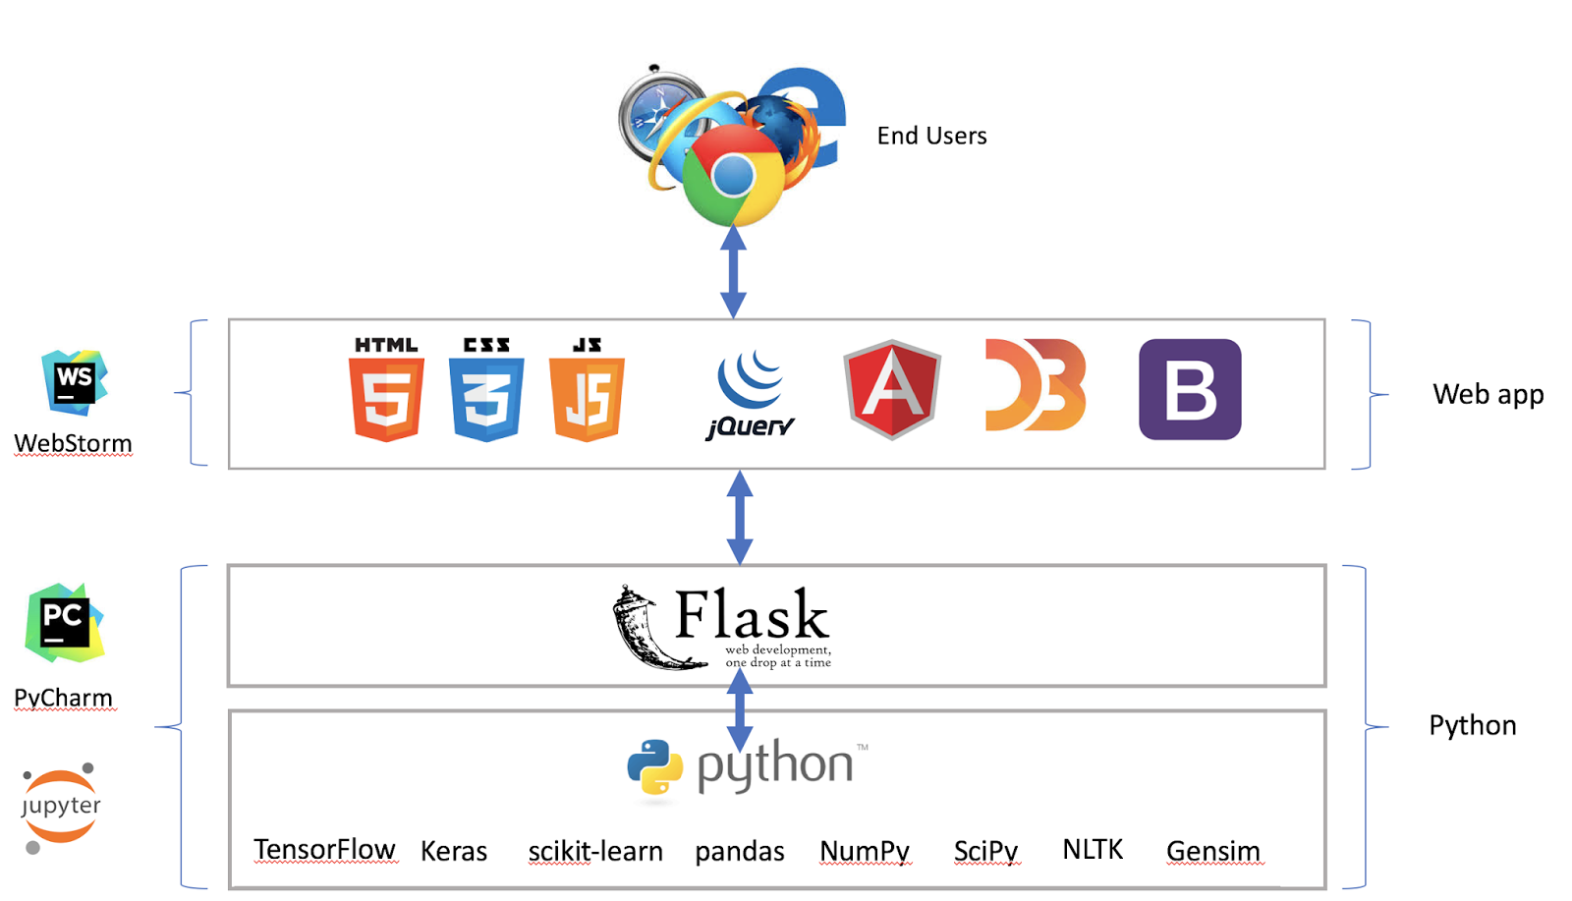
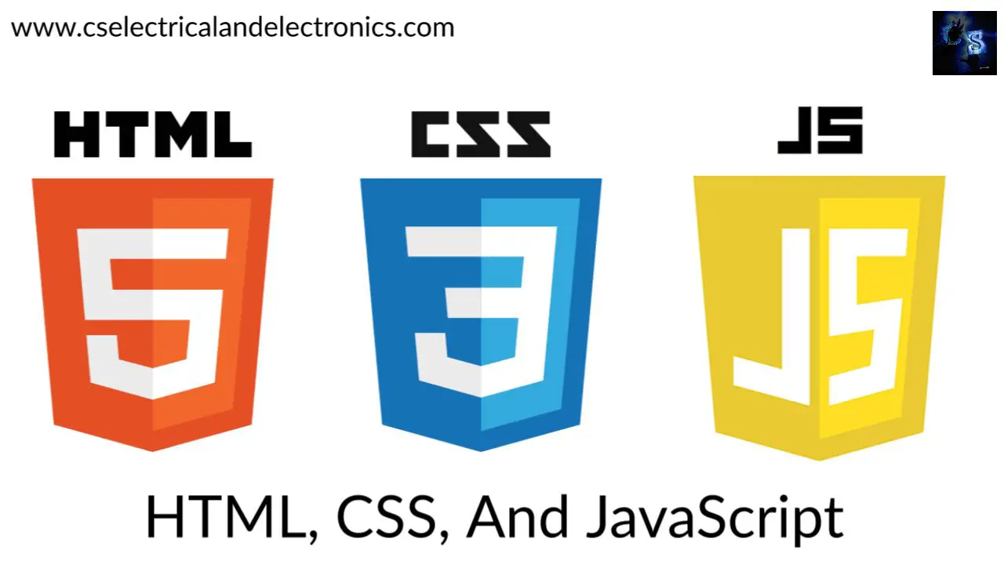
implementation

Slide 11
Literature Survey
AUTHOR | TITLE | PURPOSE | ALGORITHMS USED
M. Marimuthu , S. Deivarani , R. Gayathri | Analysis of Heart Disease Prediction using various ML techniques | To achieve better accuracy and to make the system more efficient so that it can predict the chances of heart attack | KNN ,NB , Decision tree SVM
S. Selvakumar, K. Senthamarai Kannan and S.GothaiNachiyar | Prediction Of Diabetes Diagnosis Using Classification Based ML Techniques | To achieve better accuracy and to make the system more efficient so that it can predict the chances of Diabetes | Logistic Regression, K-Nearest neighbor algorithm

Slide 12
Literature Survey
AUTHOR | TITLE | PURPOSE | ALGORITHMS USED
Amaral , Jayalakshmy | Lung disease classification using machine learning algorithms | To achieve better accuracy and to make the system more efficient so that it can predict the chances of Lung Disease | K-Nearest Neighbor, Support Vector Machine
J. Snegha, Baisakhi Chakraborty | Kidney Disease Prediction using Machine Learning | To achieve better accuracy and to make the system more efficient so that it can predict the chances of Kidney Disease | K-Nearest Neighbor, Logistic Regression, Decision Tree, Random Forest, Naïve Bayes, Support Vector Machine

Slide 13
CONCLUSION
The web application is successfully created, user needs to provide information, which is stored in model of flask, and the data is input for the trained machine learning algorithms. Here we used Random Forest and svm classification algorithms which will produce better accuracy . And finally displayed the output in new html page like if the patient has serious issue it displays consult doctor otherwise it displays as you are healthy. The application is tested fine and properly debugged

Slide 14
THANK YOU

